Slide 1
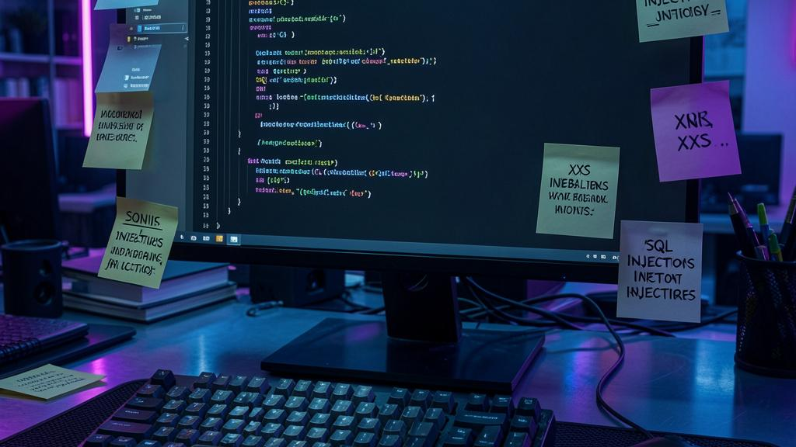
Web Attacks & Data Privacy Project Proposal
Team Members:
OWASP Vulnerability Assessment PlatformDemonstrating, Testing, and Mitigating Web Application Attacks
Yousef Yousef 213521073 khairy kreem 324845809
Mohamed Hanif 212924211

Slide 2
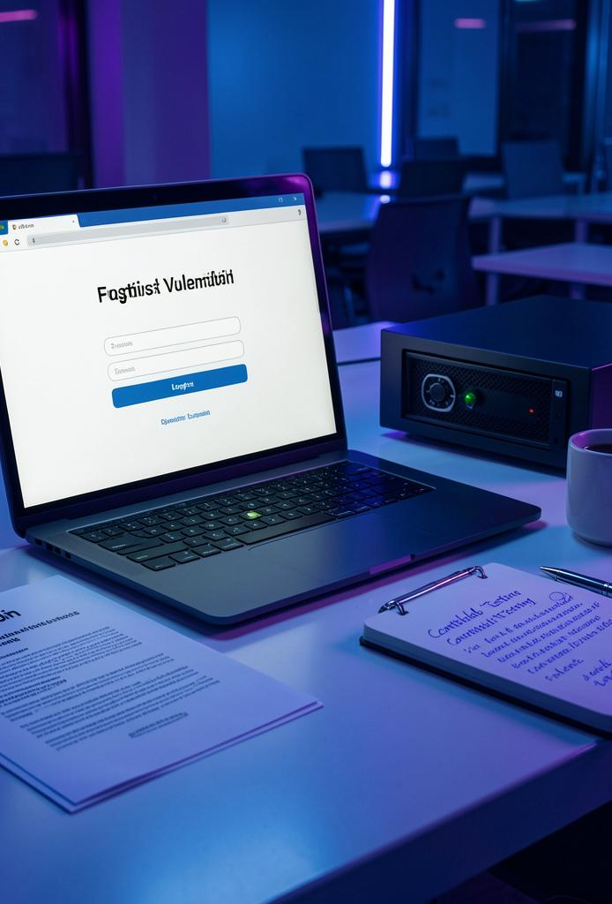
Rational – Main Objectives & Functionality
OWASP Vulnerability Assessment Platform
Project Objective
Develop a web-based platform that demonstrates, tests, analyzes, and mitigates multiple OWASP web application vulnerabilities in a controlled environment.
Main Functionality
• Simulate common web attacks including:
SQL Injection (SQLi)
Cross-Site Scripting (XSS)
Cross-Site Request Forgery (CSRF)
Server-Side Request Forgery (SSRF)
• Integrate Burp Suite for vulnerability testing and attack analysis.
• Capture and analyze network traffic using Wireshark.
• Implement secure coding techniques:
Parameterized SQL queries
Input validation
Output sanitization
Session protection
• Develop a Python-based attack automation module that automatically executes predefined attack payloads and records the results.
• Implement a statistics-based threat detection mechanism that monitors request patterns, failed login attempts, and suspicious user activity.
• Demonstrate both vulnerable and secure implementations to compare attack success and mitigation effectiveness.

Slide 3
Course Link – Topics Mapped to Implementation
Course Topic | Implementation in Our Project
Web Application Architecture | Client → Flask server → Database communication
SQL Injection Attacks | Login bypass and database extraction scenarios
Cross-Site Scripting (XSS) | Stored XSS attack through comment/input fields
Cross-Site Request Forgery (CSRF) | Unauthorized actions performed through authenticated sessions
Server-Side Request Forgery (SSRF) | Server-side URL requests to unauthorized resources
OWASP Vulnerabilities | Demonstration of common web security weaknesses
Network Analysis | Wireshark used to capture and analyze attack traffic
Security Testing | Burp Suite and Wireshark used for attack analysis and testing
Security Mitigation | Input validation, output sanitization, parameterized queries, session protection
Data Privacy | Demonstrating risks of exposing sensitive user data
Threat Detection | Request analysis and attack classification module

Slide 4
Leading Products in the Market
Several commercial and open-source security products are designed to protect web applications against attacks such as SQL Injection and Cross-Site Scripting.
Burp Suite
Description: A professional web application security testing platform used for penetration testing and vulnerability assessment.
Advantages
Intercepts and modifies HTTP requests
Automated vulnerability scanning
Supports SQLi, XSS, CSRF, and SSRF testing
Disadvantages
Advanced features require a paid version
Learning curve for beginners
OWASP ZAP (Zed Attack Proxy)
Description: An open-source web application security scanner developed by OWASP.
Advantages
Free and open source
Automated vulnerability scanning
Suitable for educational projects
Active OWASP community support
Disadvantages
Less powerful than Burp Professional
More limited automation features
ModSecurity (Web Application Firewall)
Description: An open-source Web Application Firewall (WAF) used to detect and block malicious requests.
Advantages
Protects against common OWASP attacks
Highly customizable
Widely adopted
Disadvantages
Complex configuration
Can generate false positives

Slide 5
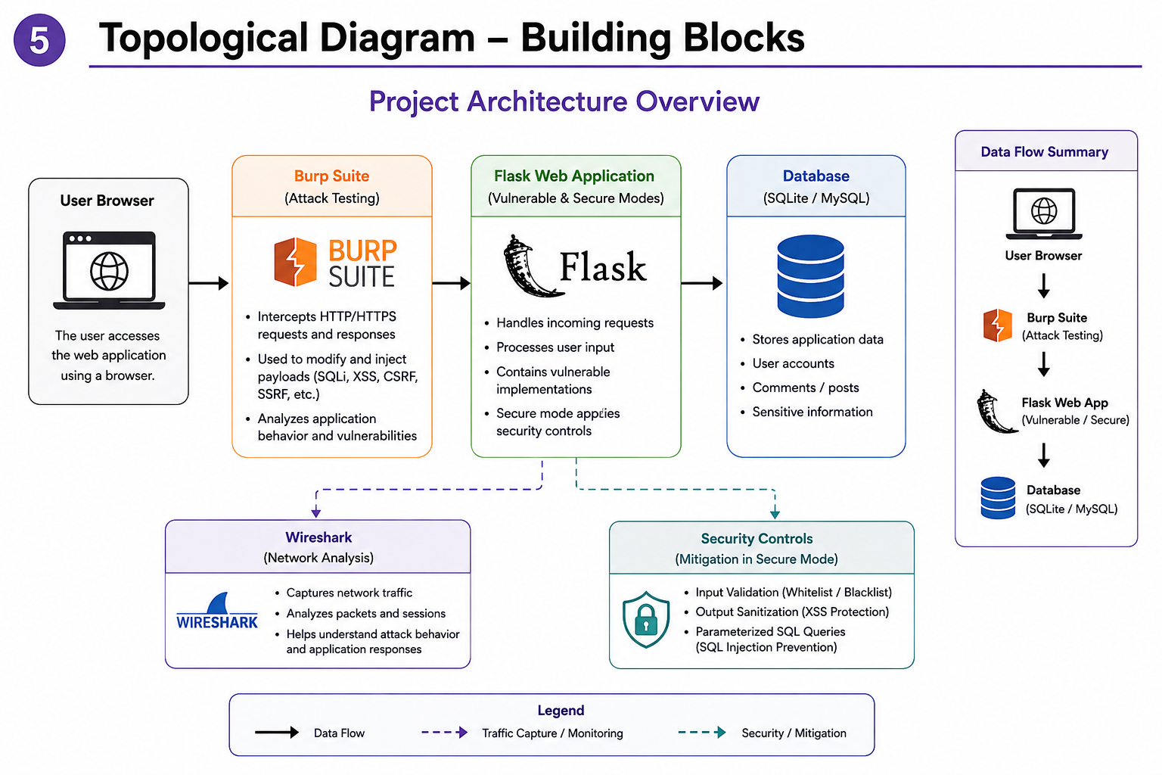

Notes:
בשקופית הזאת ניתן לראות את הארכיטקטורה הכללית של המערכת.
המשתמש ניגש לאתר דרך הדפדפן.
Burp Suite כל הבקשות עוברות דרך
שמאפשר לנו ליירט, לשנות ולבדוק את ,
התקשורת בין המשתמש לשרת.
Flask השרת עצמו מבוסס על
וכולל גם גרסה פגיעה וגם גרסה מאובטחת של המערכת. השרת מטפל בבקשות המשתמש, מעבד את הקלט ומתקשר עם מסד הנתונים.
במסד הנתונים נשמרים המשתמשים, התגובות והמידע הרגיש המשמש את תרחישי ההתקפה.
Wireshark , במקביל
משמש ללכידת וניתוח תעבורת הרשת כדי להבין כיצד ההתקפות נראות ברמת התקשורת. לבסוף, בצד ימין למטה ניתן לראות את
מנגנוני ההגנה שנפעיל במצב המאובטח, כולל
Input Validation,
.Parameterized Queries־ ו Output Sanitization
באמצעות הארכיטקטורה הזאת נוכל להדגים את ההתקפות, לנתח אותן ולבדוק כיצד מנגנוני ההגנה מצליחים
לחסום אותן."

Slide 6
Technology – OS, Languages, Tools, DB, Libraries
Programming Language: • Python Framework: • Flask Frontend: • HTML • CSS • JavaScript Database: • SQLite / MySQL
Libraries: • Flask • sqlite3 • requests • werkzeug Security & Testing Tools: Burp Suite
Intercept and modify HTTP requests
Test SQLi, XSS, CSRF, SSRF payloads
Wireshark
Capture and analyze network traffic
Browser Developer Tools
Inspect client-side behavior and requests
Rationale for Choice: Python and Flask provide a lightweight environment for quickly building vulnerable and secure web application scenarios. Burp Suite and Wireshark allow practical testing, traffic capture, and attack analysis.
Notes:
"בשקופית הזאת מוצגות הטכנולוגיות שבהן נשתמש בפרויקט.
,Flask באמצעות Python המערכת תפותח בשפת
שיאפשר לנו לבנות את צד השרת ואת מנגנוני האבטחה.
בצד הלקוח נשתמש ב
CSS ־ JavaScript־ ו HTML,
כדי לבנות את ממשק המשתמש..
MySQL או SQLite המידע יישמר במסד נתונים מסוג
requests בנוסף נשתמש במספר ספריות כמו
לצורך ניהול הנתונים והתקשורת. werkzeug־ ו sqlite3,
Burp Suite־ לצורך בדיקות אבטחה נשתמש ב
־ לביצוע וניתוח
התקפות לניתוח תעבורת הרשת. Wireshark
־ בחרנו בטכנולוגיות האלו
משום שהן פשוטות יחסית למימוש, נפוצות מאוד בעולם ה
, ומתאימות ,Web Security
להדגמת התקפות והגנות בצורה ברורה."

Slide 7
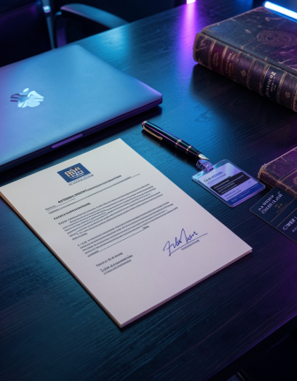
Assumptions and Constraints
Assumptions:
• The project runs in a controlled local environment.
• The attacker has network access to the web application.
• Users interact with the application using a web browser.
Constraints:
• Limited development time during the semester.
• The attacks are demonstrated for educational purposes only.
• The application will not be exposed to the public internet.
• Hardware and network resources are limited.
Notes:
הנחות והמגבלות של הפרויק
אנחנו מניחים שהמערכת פועלת בסביבה מקומית ומבוקרת,
כאשר המשתמשים והתוקף ניגשים אליה באמצעות
דפדפן רגיל.
מבחינת מגבלות, הפרויקט מפותח במסגרת זמן מוגבלת במהלך הסמסטר, וכל ההתקפות מיועדות למטרות
לימוד והדגמה בלבד.
בנוסף, המערכת לא תהיה חשופה לאינטרנט הציבורי, אלא תפעל בסביבת מעבדה בטוחה ומבוקרת."

Slide 8
Scenario 5 – Server-Side Request Forgery (SSRF)
Description: The attacker manipulates server-side URL requests to access unauthorized resources.
Expected Result: Access to internal or restricted services through the web server.
Scenario 6 – Security Testing and Traffic Analysis
Description: Burp Suite and Wireshark are used to intercept, analyze, and monitor attack traffic.
Expected Result: Identification of vulnerabilities and visualization of attack behavior.
Scenario 7 – Secure Mode Demonstration
Description: The vulnerable implementation is replaced with secure coding techniques.
Expected Result: SQLi, XSS, CSRF, and SSRF attacks are blocked through validation, sanitization, and secure session handling.
Scenario 8 – NoSQL Injection Attack
Description: The attacker exploits insecure NoSQL queries to bypass authentication or access unauthorized information.
Expected Result: Unauthorized access to application data through malformed NoSQL queries.
Scenario 9 – Automated Vulnerability Assessment
Description: A Python automation module sends predefined attack payloads against application endpoints and records the results.
Expected Result: Automatic identification and reporting of SQLi, XSS, CSRF, SSRF, and NoSQL vulnerabilities.
Main Scenarios and Expected Results
Scenario 1 – SQL Injection Login Bypass
Description: The attacker injects SQL code into the login form to bypass authentication.
Expected Result: Unauthorized access to protected user accounts.
Scenario 2 – SQL Injection Data Extraction
Description: The attacker uses UNION-based SQL Injection to retrieve hidden database information.
Expected Result: Exposure of sensitive user data from the database.
Scenario 3 – Stored XSS Attack
Description: The attacker injects malicious JavaScript code into a comment or input field.
Expected Result: Execution of attacker-controlled scripts in another user's browser.
Scenario 4 – Cross-Site Request Forgery (CSRF)
Description: An authenticated user unknowingly submits a malicious request crafted by an attacker.
Expected Result: Unauthorized actions performed using the victim's session.

Slide 9
Challenges – Technical Challenges & Mitigation
Main Challenges:
• Creating realistic vulnerable web scenarios
• Understanding attack payload behavior
• Preventing accidental damage outside the lab environment
• Capturing network traffic correctly using Wireshark
• Implementing secure mitigation techniques
• Synchronizing frontend and backend components
Mitigation Approaches:
• Testing only in isolated local environments
• Using virtual machines when needed
• Applying secure coding standards
• Logging requests and errors for debugging
• Using parameterized queries and input sanitization

Slide 10
Main Algorithms
1. SQL Injection Detection Logic
Analyze user input for suspicious SQL patterns.
Detect keywords such as:
' OR 1=1
UNION
SELECT
--
Flag or block malicious requests before database execution.
5. Statistics-Based Threat Detection Algorithm
Purpose: Identify suspicious behavior based on request patterns.
Process:
Monitor request frequency.
Count failed login attempts.
Track suspicious keywords.
Detect abnormal traffic behavior.
Flag potential attacks for further analysis.
2. Input Validation Algorithm
Validate input length and format.
Reject unexpected characters and invalid values.
Prevent malicious data from reaching the application logic.
6. Automated Vulnerability Testing Algorithm
Purpose: Automatically assess application security.
Process:
Load attack payloads.
Send automated requests.
Analyze responses.
Record successful exploit attempts.
Generate testing results.
3. XSS Prevention Algorithm
Sanitize user-generated content.
Escape HTML and JavaScript special characters.
Encode output before displaying it in the browser.
4. Security Testing Workflow
Intercept HTTP requests using Burp Suite.
Inject test payloads for SQLi, XSS, CSRF, and SSRF.
Analyze application responses to identify vulnerabilities.

Slide 11
High Level Planning – Roles & Milestones
Phase 1 – Research & Planning
Study OWASP vulnerabilities and attack techniques.
Define system architecture and project requirements.
Design attack scenarios and testing workflow.
Phase 2 – Development
Khairy kreem
Backend & Database
Flask application development
Database integration (SQLite/MySQL)
SQL Injection implementation and mitigation
Phase 3 – Security Testing
Execute SQLi, XSS, CSRF, and SSRF attack scenarios.
Capture and analyze traffic using Wireshark.
Test secure-mode protections and mitigations.
Validate application behavior using Burp Suite.
Yousef Yousef
Frontend & Client-Side Security
User interface development
XSS attack implementation
CSRF attack implementation
Phase 4 – Documentation & Presentation
Prepare final report.
Update presentation slides.
Record demonstration video.
Document attack results and mitigation effectiveness.
Mohamed Hanif
Security Testing & Analysis
Burp Suite integration
SSRF attack implementation
Wireshark traffic analysis
Security testing documentation

